Slide 1

From Sand to Superchips
—— The Silicon Age
BY
莫天皓 刘晓轩 崔皓泉

Slide 2
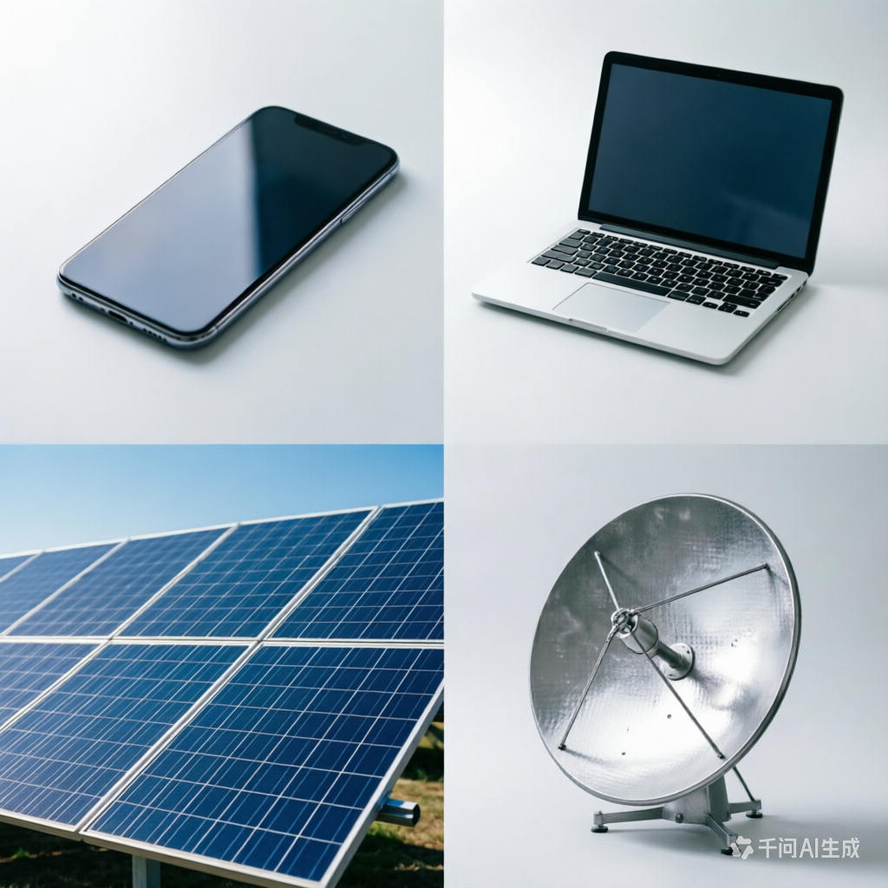

1.1 The Story of Silicon
Where is it?
It is everywhere around us.
1. In sand, rocks, and soil (as silicon dioxide, or quartz)
2. In glass, ceramics, and concrete
3. In the microchips inside your phone, computer, and smart devices
4. Even in some plant and animal tissues!
Silicon’s ubiquity is what makes it so special: it’s not a rare or exotic material—it’s the foundation of our natural world, and now, our digital one too.

Slide 3
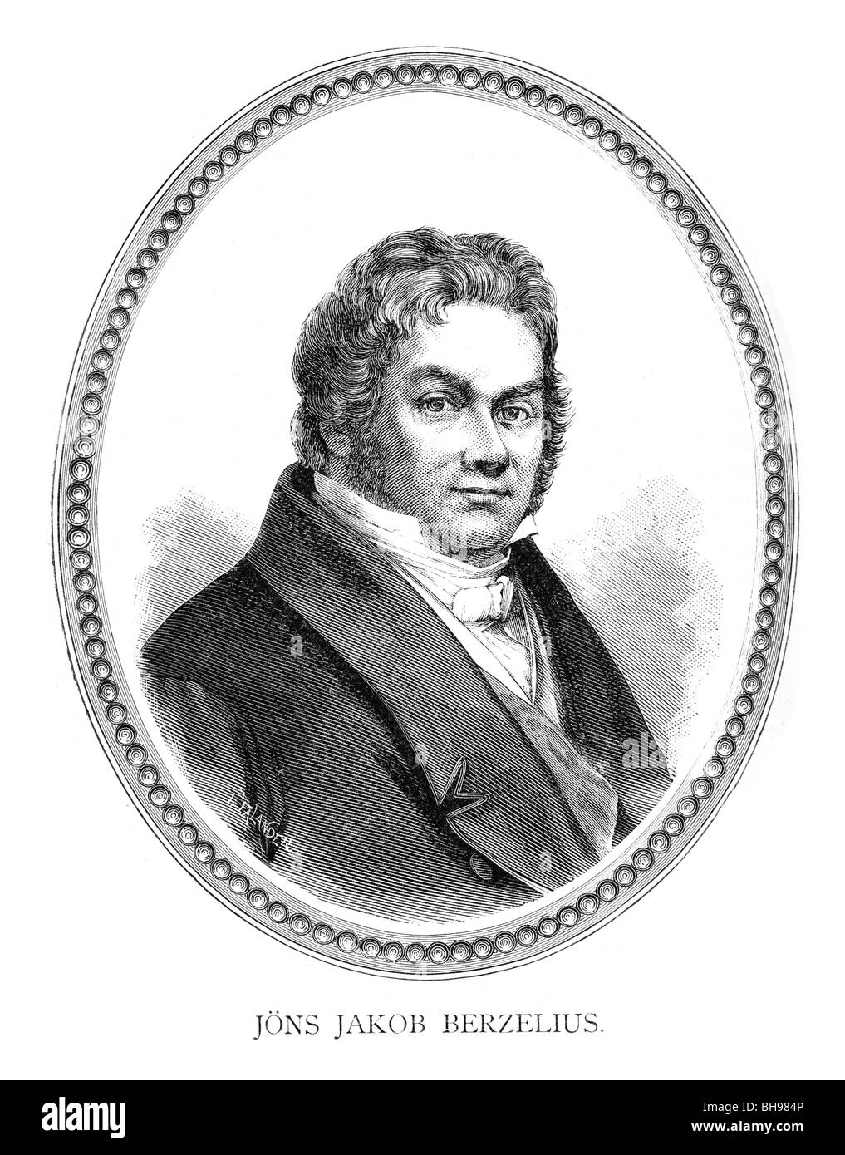
1.2 The Discovery
Initial State: A dirty brown powder with no obvious practical applications
Discovered by Jöns Jacob Berzelius in 1823
Initially dismissed as a chemically inert, useless material
Its semiconductor properties would remain unrecognized for over a century

Slide 4
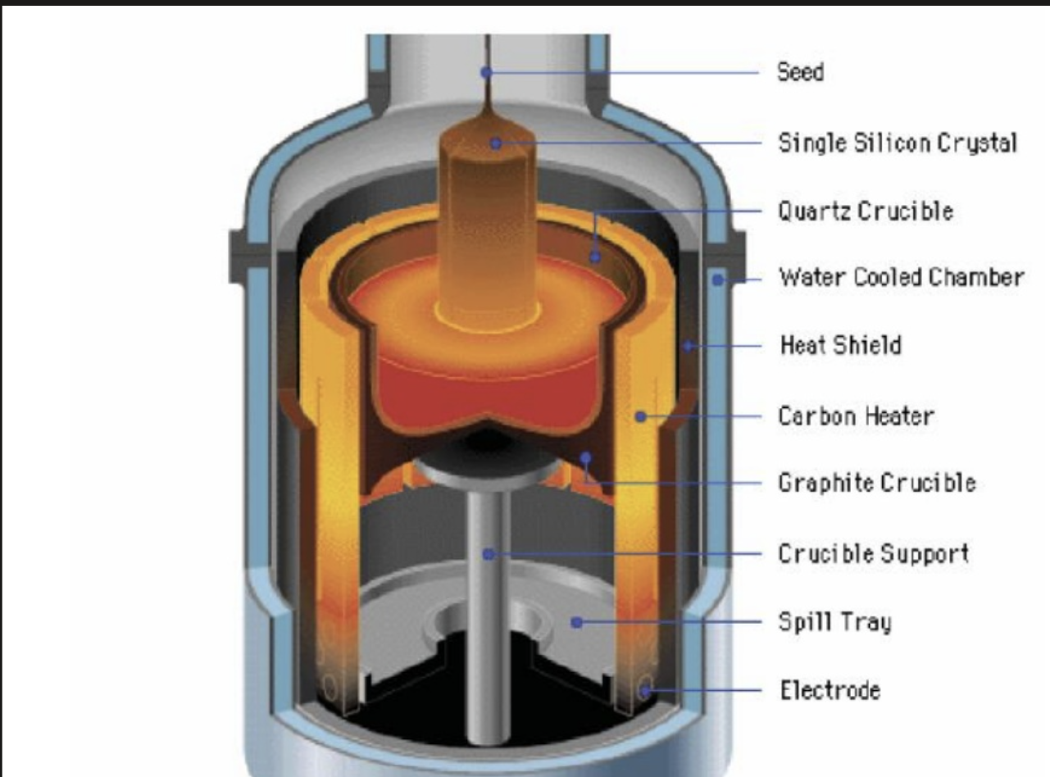
1.3 Development
Early Development (1940s)
The Goal: Turning powder into clean crystals
The Process (Czochralski Method):
Dip: Dip a tiny seed into melted silicon
Pull: Slowly pull up to form a solid cylinder
Cut: Cut the cylinder into thin slices
Final Product: Silicon Wafers

Slide 5
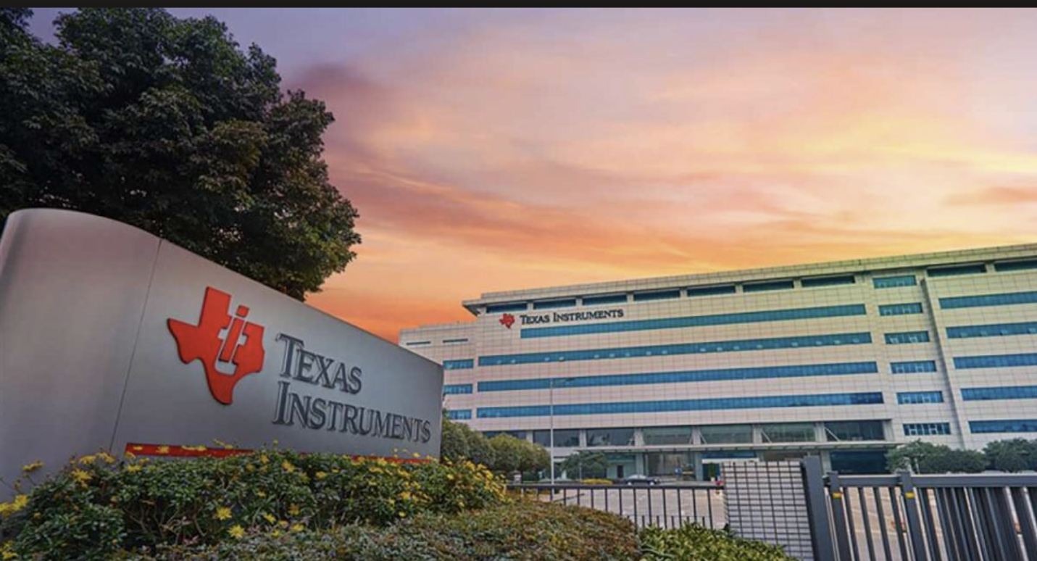
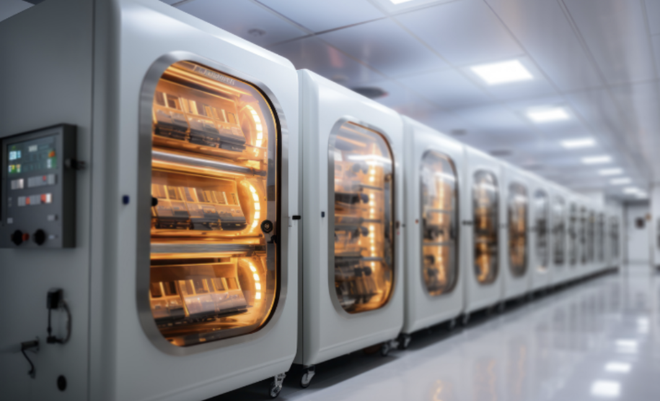

1.3 Development
The Big Breakthrough (1954)
Milestone: First Silicon Transistor, by Texas Instruments)
The Shift: From Germanium to Silicon
Why Silicon Wins?
Heat Resistant (Stable in high temperatures)
Cost Effective (Cheap & Abundant from sand)

Slide 6
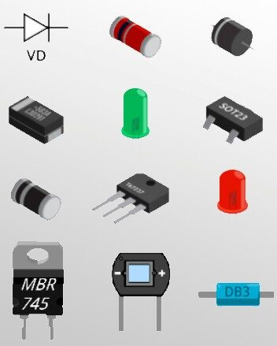
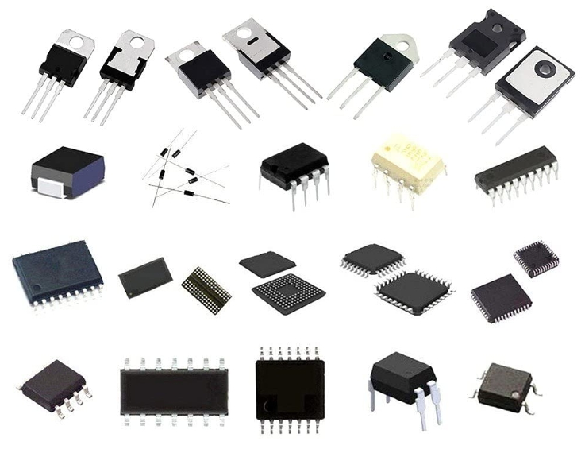
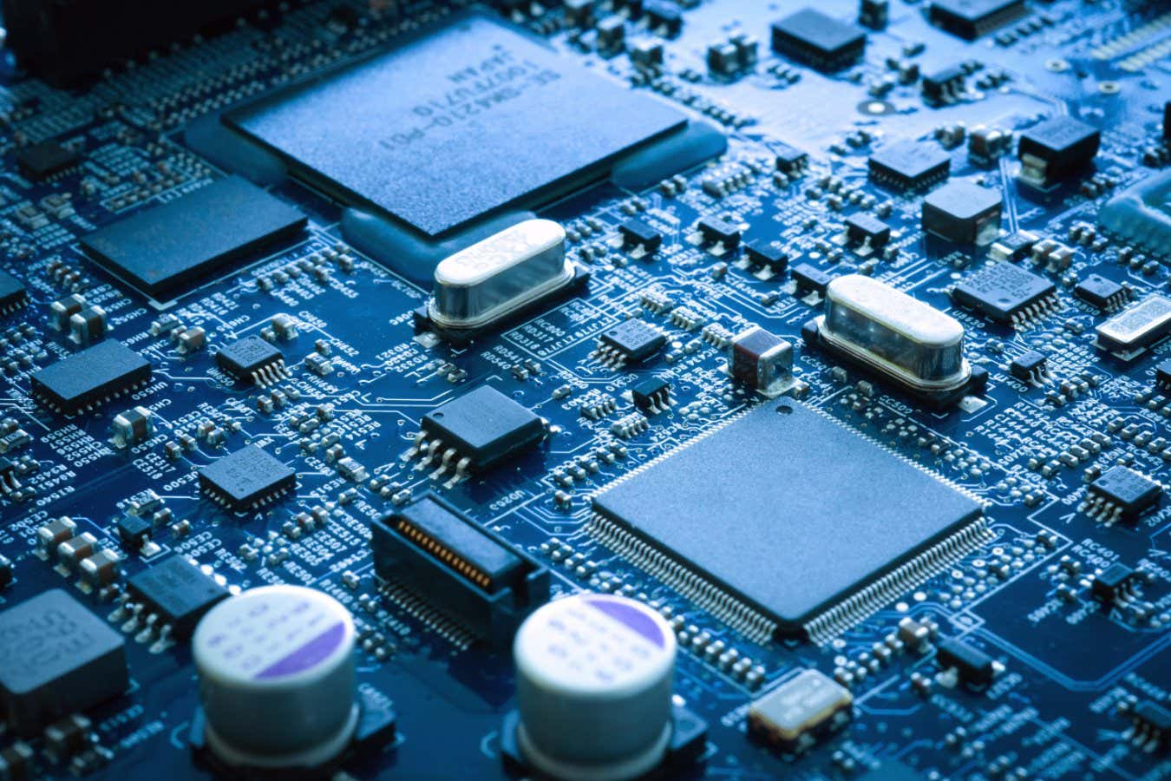
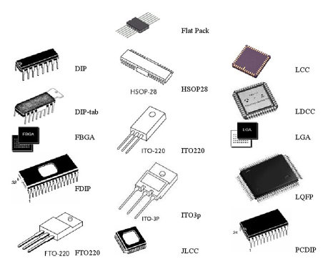
2. Application Scenarios
Electronics & Semiconductors
Most significant and impactful application.
Basic material of almost all the modern electronics and semiconductors
Foundation of modern computing, phones, AI service and etc.
Diode
Transistor
Semiconductors
Silicon Chips

Slide 7

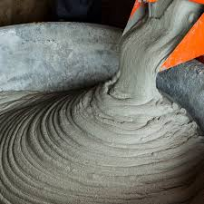
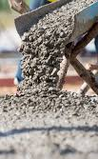
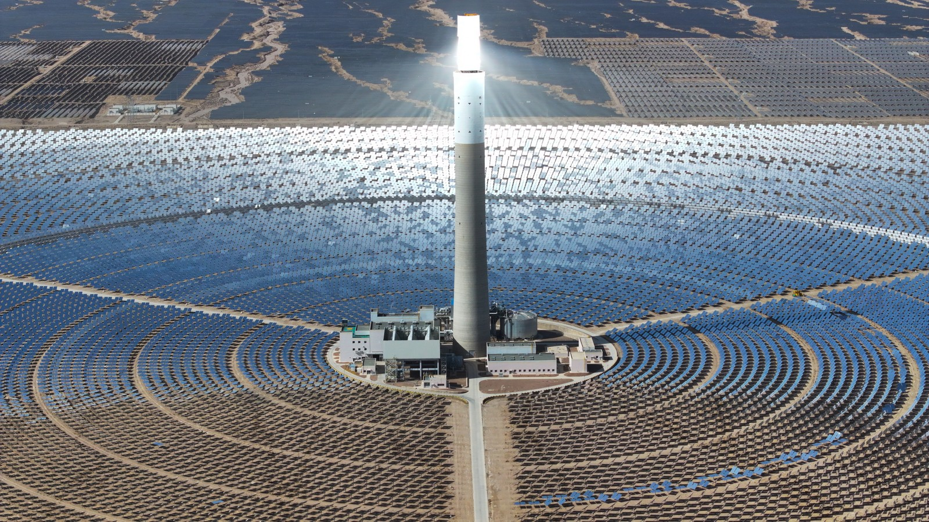
2. Application Scenarios
Solar Energy Panels
Dominant material in solar panels
Used for producing green and clean energy
Silicon-based solar cells are central to reducing reliance on fossil fuels.
Glass
Cement
Concrete
Construction Materials
Silicon compounds (SiO₂) are essential for making glass, cement, and concrete. Cornerstone of infrastructure—buildings, roads, bridges, and windows……
Solar Energy Panels

Slide 8

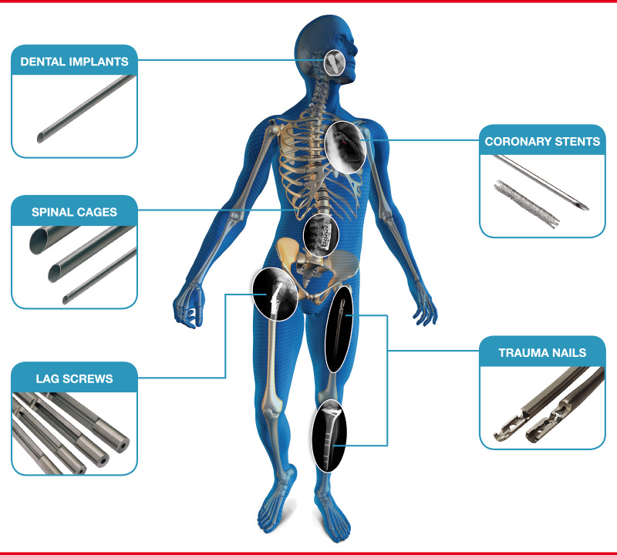
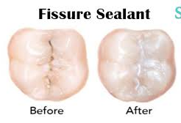
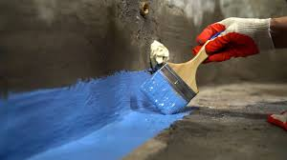
2. Application Scenarios
Silicones in Chemical & Medical Use
Widely used in sealants, lubricants, medical implants, and waterproofing.
Flexibility, durability, and biocompatibility
Lubricant
Medical Implants
Sealants
Waterproofing

Slide 9

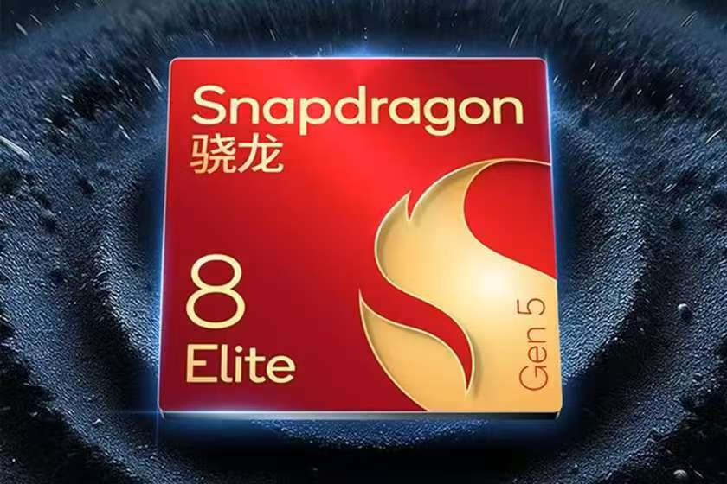

3. Latest R&D
Smaller Chips
Companies are now making chips with 3 nanometers and 2 nanometers technology.
That is super tiny. But it is also very hard and expensive. Heat and electricity leaks are big problems.

Slide 10

3. Latest R&D
New Helper Materials.
Pure silicon has limits. So scientists use silicon carbide (SiC) and gallium nitride (GaN). Big words, but simple meaning: these materials can work with higher power and higher heat. They are used in electric cars and fast chargers. They do not replace silicon – they work together.
Green and Low-carbon.
Making pure silicon needs a lot of energy. And old solar panels or old computers create electronic waste. Therefore, researchers are finding ways to recycle silicon from old products. Also, they try to use less energy when making new silicon.

Slide 11
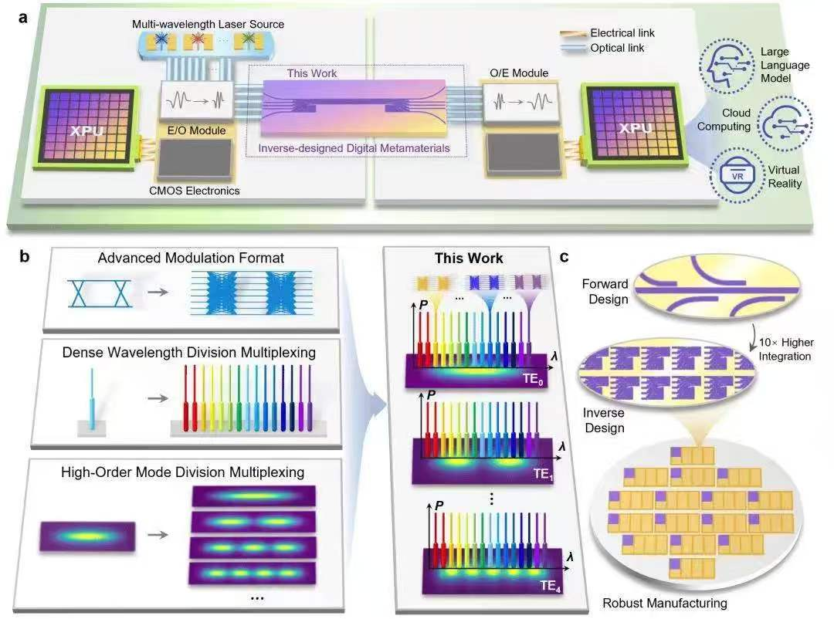
4. Future
We may see silicon photonics – using light instead of electricity to send information inside a chip. That would be faster and use less power.

Slide 12
4. Conclusion
Silicon started as simple sand. Then it became the heart of all electronics. Today, it gives us computers, solar power, and smart cars. Tomorrow, with new ideas and green methods, silicon will stay important.

Slide 13
Thanks for listening!

